Slide 1
Scheduling of Software

Slide 2
Software project management
Project planning involves:
Project scope definition (WBS)
Software estimation (cost/effort required)
Software scheduling (time required)
Bar charts/activity networks
Gantt charts

Slide 3
project Scheduling
Split project into tasks
estimate time and resources required to complete each task.
Organize tasks concurrently to make optimal use of workforce.
Minimize task dependencies to avoid delays between tasks.
Dependent on project managers intuition and experience.

Slide 4
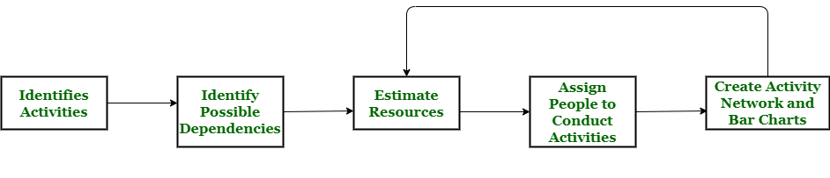
Project scheduling process

Slide 5
Scheduling problems
Estimating the difficulty level of problems and predicting the cost of developing a solution is challenging.
Productivity is not proportional to the number of people working on a task.
Adding people to a late project makes it even later because of communication overheads.
The unexpected always happens. Always allow contingency in planning.

Slide 6
Project scheduling techniques

Slide 7

Bar charts & activity networks Diagrams
Graphical notations used to illustrate the project schedule.
Show project breakdown into tasks.
Activity charts show project activities & task dependencies
Bar charts show schedule against calendar time.

Slide 8
Activity network Diagrams
Model the project’s activities and their relationships as a network
2 best known techniques:
CPM (Critical Path Method) or CPA (Critical Path Analysis)
PERT (Programme Evaluation Review Technique)
Both approaches use Activity-on-Arrow approach
Activities are drawn as arrows joining circles, or nodes, which depicts the possible start and/or completion of an activity or set of activities.

Slide 9
Rules for Activity network Diagram creation
Network flow from left to right
Activity cannot begin until all its predecessors are done
Arrows can overlap each other as they shows the project flow
Every activity must have an id
Looping is not allowed
Every activity must have id > preceding activity.

Slide 10

activity network example
The necessary steps are:
Create a network project
Identify critical path
Do critical path analysis using forward and backward passes (ES, EF, LS, LF)
Calculate float/slack values
Total Float-> the amount of time that an activity can be delayed from its ES date without delaying the project finish date.
Free float->the amount of time an activity can be freely delayed without affecting the early start of the following activity.

Slide 11
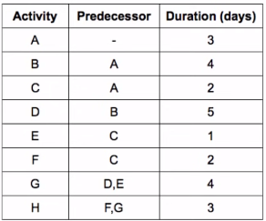
activity network example

Slide 12
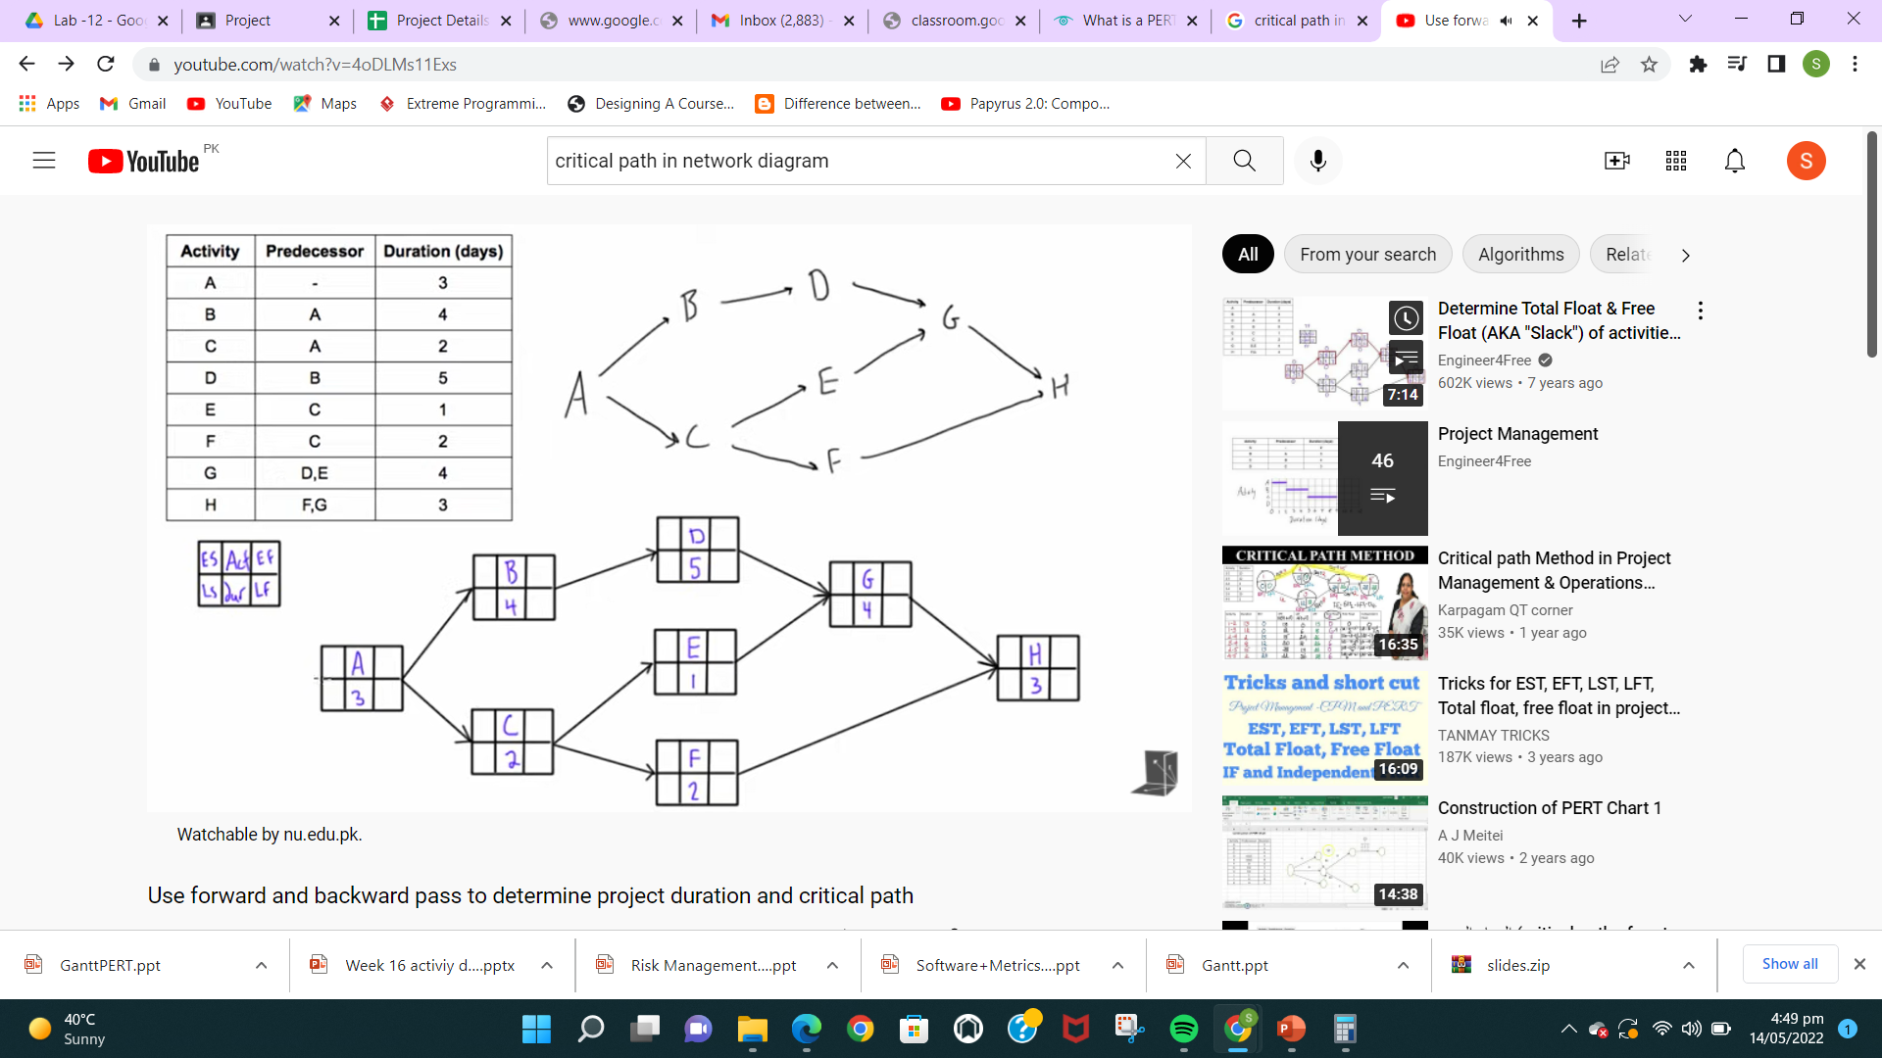
Draw Activity network

Slide 13
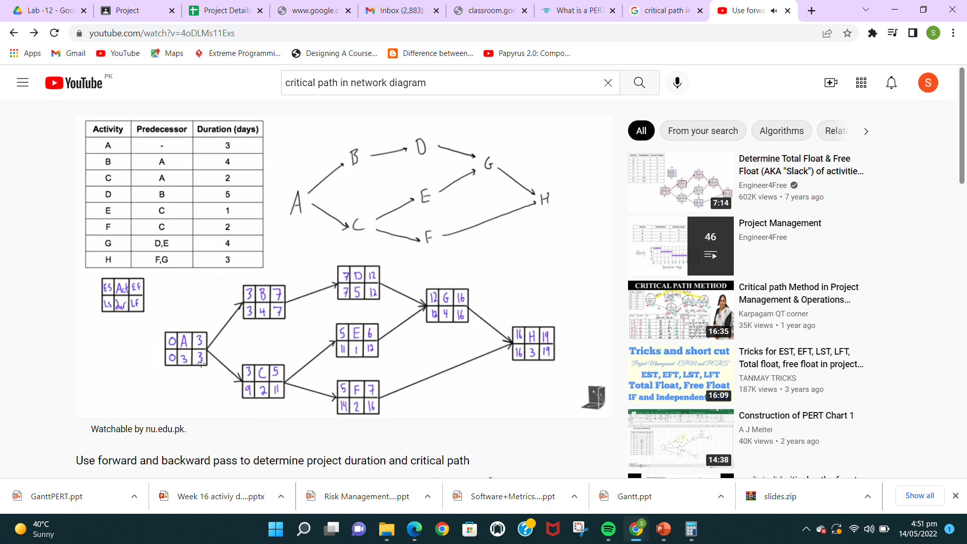
Mention ES, EF, LS, LF

Slide 14
Identify paths and label critical path
A,B,D,G,H = 19
A,C,E,G,H = 13
A,C,F,H =10

Slide 15
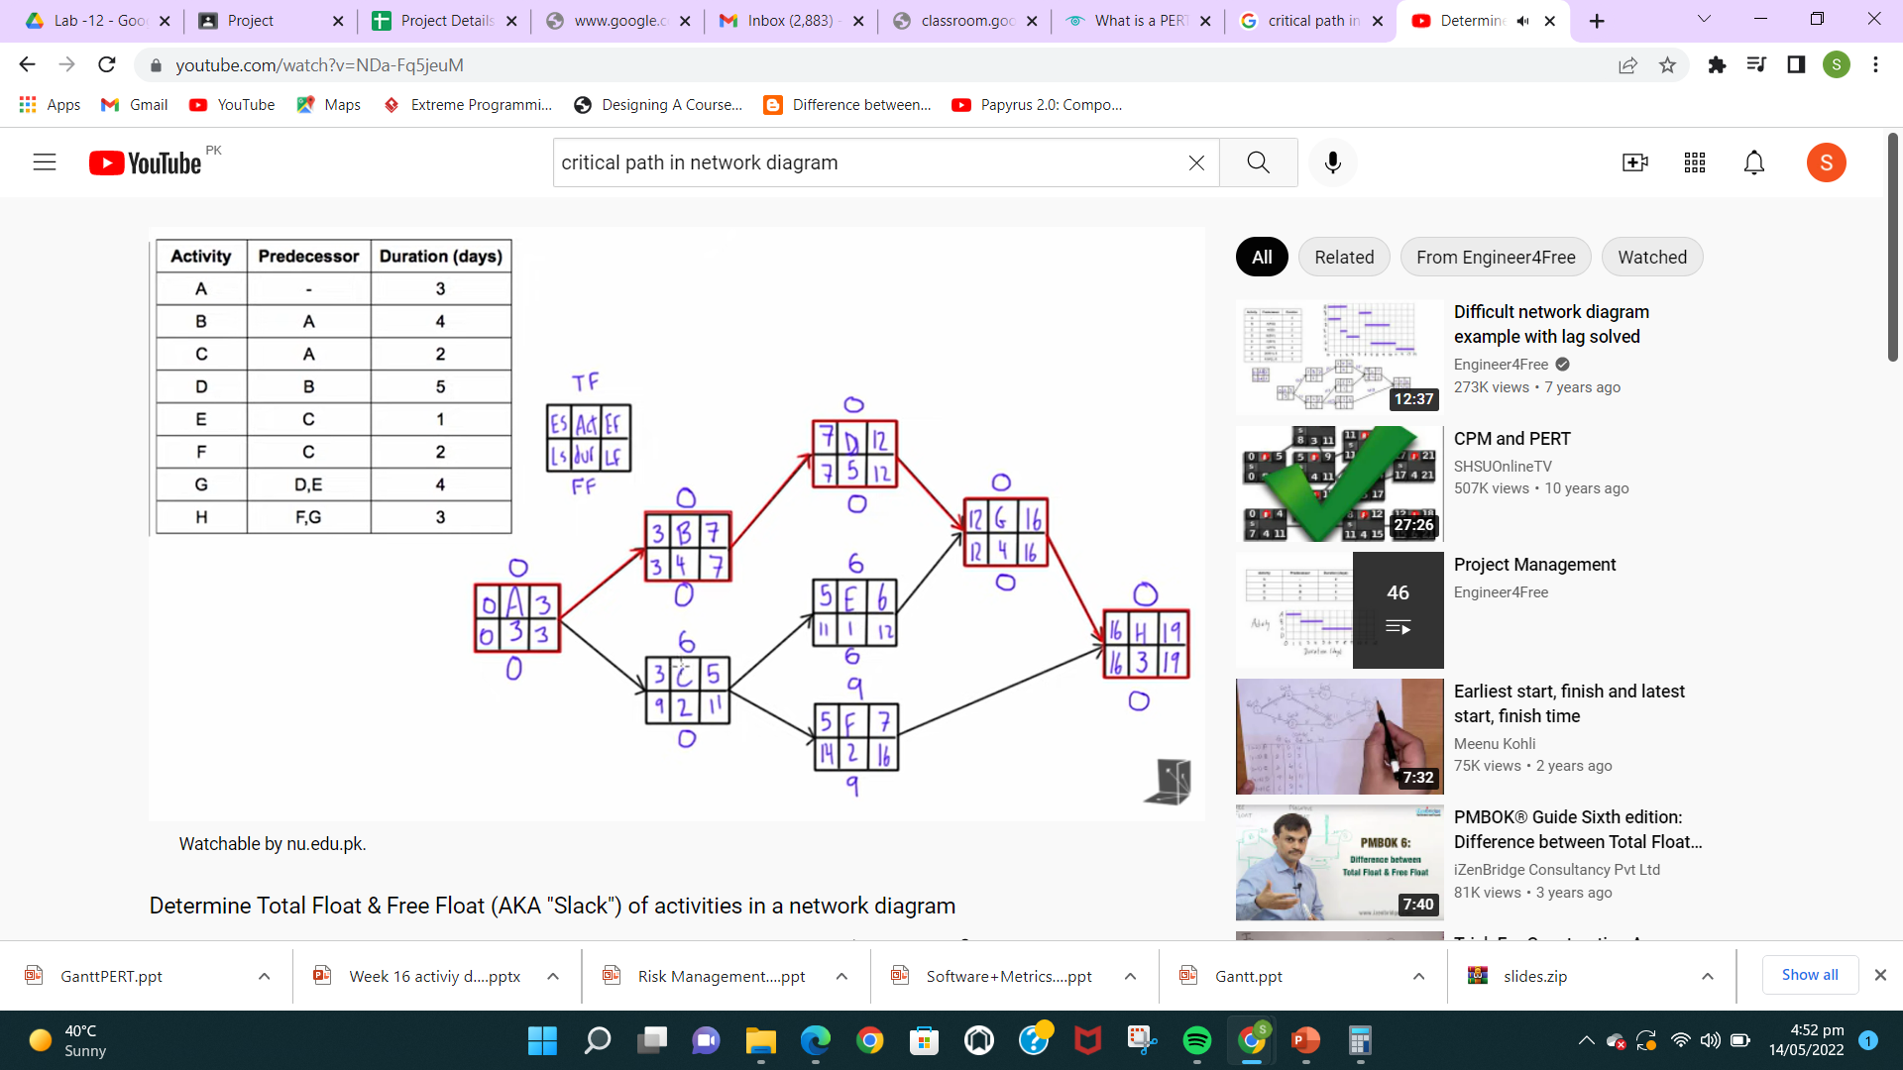
IDENTIFY TOTAL SLACK/FLOAT, FREE SLACK/FLOAT
TF = LF-EF OR LS-ES
FF = MIN (ES_{SUCCESSOR}) – ES _{ACTIVITY} – DURATION_{ACTIVITY}

Slide 16
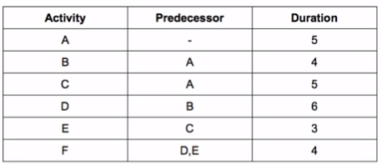
Example # 2
Draw activity diagram
Identify early start or finish and late start or finish date
Identify all paths and mention critical path
Calculate slack values

